Slide 1

Student Orientation Handbook
Welcome Students

Slide 2
Welcome
WinnMed is dedicated to providing students interested in health careers the opportunity to learn about rural healthcare in the hospital or clinic setting.
Aspects of the student experience are coordinated through the Education Office. Please go through Education rather than contacting our staff directly.
If you have any questions regarding the material presented in this orientation, please contact the Education Department.

Slide 3
Orientation Topics
This orientation will cover:
General facility orientation, such as our mission, dress code, parking, customer service and diversity
Your safety, and the safety of our patients, and confidentiality and privacy of our patients.

Slide 4
Mission of WinnMed
WinnMed is a lifelong community partner improving the health and well-being of those we serve through patient – centered collaboration worthy of the trust our patients place in us.

Slide 5
Vision Statement
WinnMed provides an unparalleled experience as the most trusted partner for health care.

Slide 6

Values
Primary Value
The needs of the patient come first.
Values
Respect
Integrity
Compassion
Healing
Teamwork
Innovation
Excellence
Stewardship

Slide 7
Student Roles
Education Department
Clinical Rotation
Job Shadow
Internship
Students have three primary roles
As a student, your patient care responsibilities must align with your current level of training and education. Approved clinical experiences are determined by your school and guided by your supervising preceptor. For specific details, please refer to your school’s affiliation agreement or contact the Education Department

Slide 8
Policy and Procedures
Patients come first at WinnMed
WinnMed retains the right to end any student experience of a student found violating WinnMed policies, procedures, or guidelines

Slide 9

Name Badge
WinnMed requires all students to wear an identification badge indicating student status.
Either--
A school-issued photo ID badge or
A student ID provided by WinnMed
Badges should be worn at chest level

Slide 10

Tobacco Free Campus
WinnMed campuses are tobacco free. This includes smokeless and smoked products.
Use of tobacco is not allowed in vehicles while parked on our campus.
Students should not smell of cigarette smoke while at any of our campuses.

Slide 11
Parking
Please park in Lot B, Main Entrance unless directed otherwise
It is very important that you enter where you were told in the email you received. Ask if you do not know where to report.
Park further away to leave closer parking spots for our patients and other visitors.

Slide 12
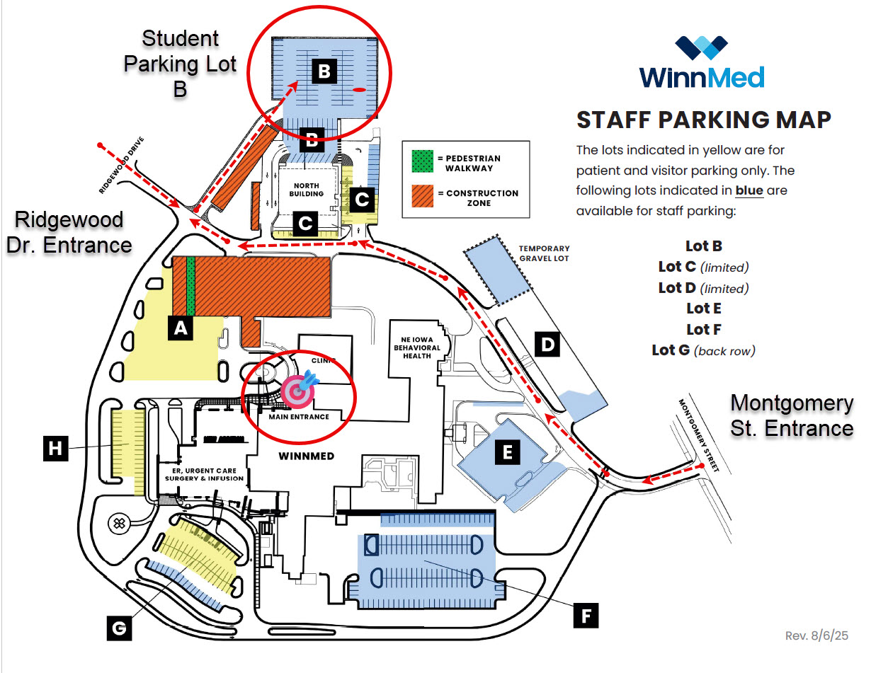
Student Parking-Lot B

Slide 13
Timeliness/Attendance
Students should arrive promptly.
If you cannot attend, it is very important that you contact the department you are scheduled in to let them know of your absence.
Also email education@winmedical.org to let them know you will not be attending as scheduled and if the reason for your absence is an illness.

Slide 14
Background Screening
WinnMed requires a background check or will conduct a simple state court records search.
Schools should provide you with a background screening upon admission for clinical programs.
Students may need to provide authorization to WinnMed Staff to conduct a criminal, sex offender and sanctions check if their school has not provided one to WinnMed.

Slide 15
Conduct and Behavior
Professional behavior is expected.
Discussions should be conducted in a confidential manner.
You are expected to be supervised by a WinnMed staff member at all times.

Slide 16
Alcohol and Drugs
WinnMed prohibits the use, possession, transfer and/or sale of alcohol and/or illegal drugs while working, while on all premises owned, leased, or otherwise controlled by WinnMed and while operating any company vehicle, machinery, or equipment.

Slide 17

Phones and Mobile Devices
Personal cell phones must be turned off during your experience and stored with your personal belongings.
Cell phones and / or cameras are not allowed in patient care areas.
Texting or social media use during “work” hours is not allowed.
Scheduled breaks (lunch, rest room) would be the appropriate time to check your phone.
Please let family and friends know prior to your time at WinnMed that you are occupied during the hours of your experience, so patient care is not interrupted by your devices.

Slide 18



Dress Code
Professional attire helps establish professionalism, pride, and respect for the organization. All students must adhere to the dress code.

Slide 19

Dress Code Cont.
ACCEPTABLE
School uniform or solid scrubs are acceptable.
WinnMed prefers a black or white long sleeved shirt under your scrubs if one is needed.
Clean tennis shoes or work shoes must be worn with your scrubs/uniform.
Surgery will provide you with WinnMed issued scrubs for the day.
Black, tan, gray or brown khaki type or dress pants. (appropriate in the Rehab dept. also)
Skirts (must be no more than 2 inches above knee)
Closed toe shoes are required
Ties project professionalism, but are not required at WinnMed
UN-ACCEPTABLE
Denim
T-shirts
Sweatshirts or hoodies
Shorts
Sleeveless or low cut tops
Shirts with logos or images
Flip flops/casual sandals/open toe
Skorts or mini skirts
Stretch pants/ leggings, yoga pants
or athletic wear
Artificial fingernails are not allowed in patient care areas due to infection control concerns.
Nail polish in patient care areas is generally discouraged.

Slide 20
Tattoos and Other Body Art
We do NOT allow offensive tattoos; the preference is to have all tattoos covered if possible.
Limit ear piercings to three earrings per ear. No bars or gauges.

Slide 21
Hygiene
All students should maintain good hygiene.
This includes:
Neat and clean clothing and hair
Absence of offensive body odor
Well maintained hair and facial hair

Slide 22
Customer Service/ Courtesy
All students will display courtesy, friendliness, and a caring attitude toward fellow students, staff, patients, volunteers, and visitors.
Acknowledge and greet each person you meet or talk with in a courteous manner.
Display patience
Make eye contact
Smile
Show respect
Use each person’s name when you know it, and use the appropriate title. It is ok to ask for a preferred pronoun and it is ok to share your pronouns.
Never use:
Honey
Dear
Sweetie

Slide 23

Customer Service / Courtesy Cont.
Knock before entering a patient’s room or procedure area.
Ask permission of the patient for everything.
Be respectful of the patient’s wishes if they do not want a student present.

Slide 24
Diversity and Inclusion
WinnMed is committed to providing equitable access to care, services, and employment without discrimination based on race, color, gender, sexual orientation, gender identity, age, national origin, religion, disability, or communicable disease status. We strive to accommodate individual needs and ensure inclusive participation across all programs and activities.

Slide 25
Language Services
Interpretive services are provided to patients and/or family members when requested or identified as a need.
Medical language interpreters meet qualifications and have training in medical interpretation. Most are certified to assure professional, competent and safe service.
Please keep patient safety in mind when an interpreter is needed and notify a WinnMed Staff member.

Slide 26

Facility Safety
General Safety
Fire Safety
Safety Codes
Infection Control

Slide 27
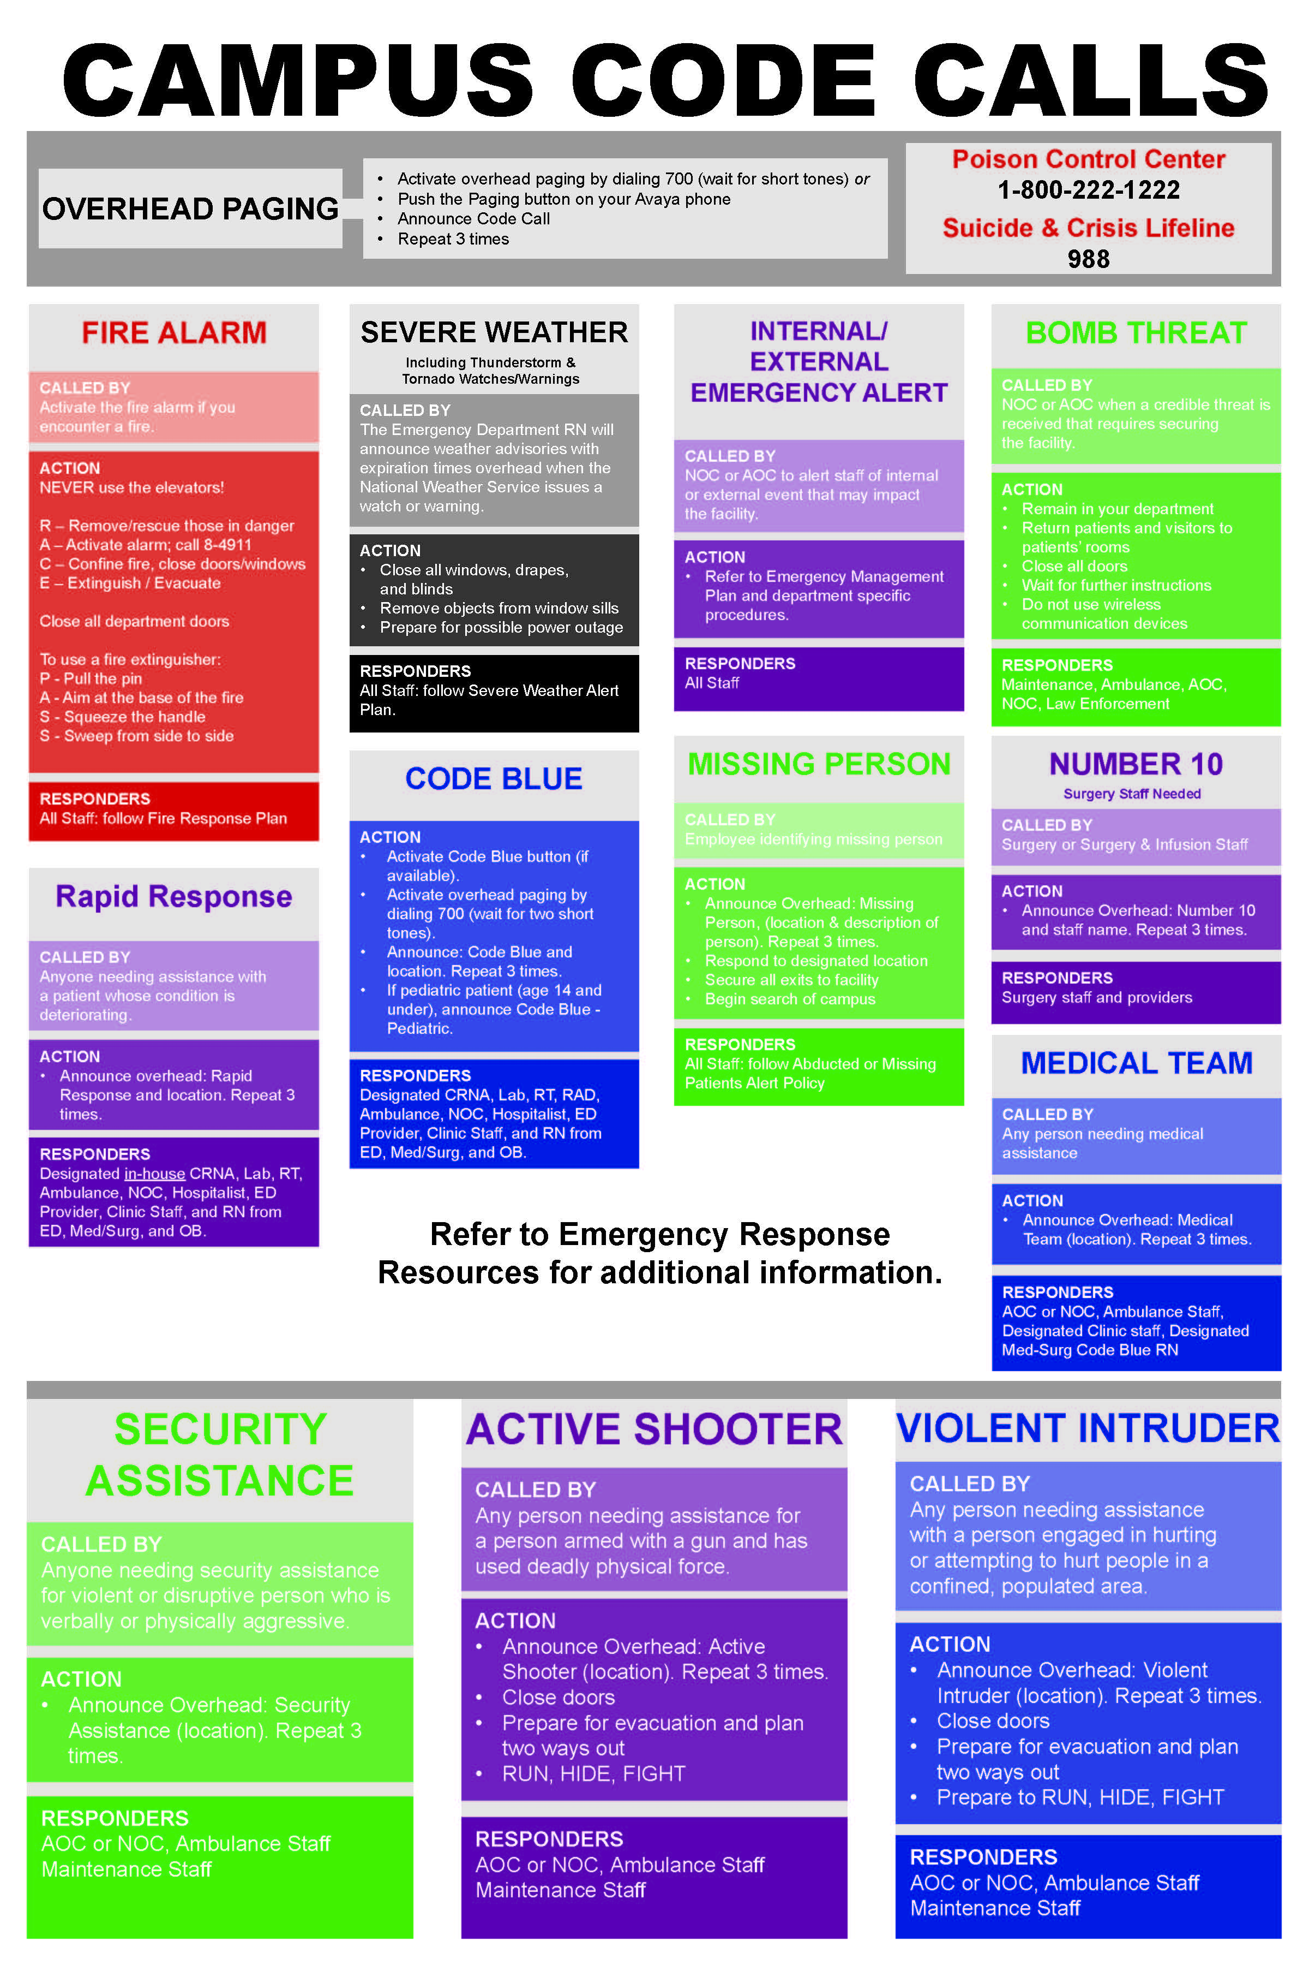

Slide 28
Directions for Safety Codes
Follow your supervisor or preceptor’s direction.
Your assistance may be needed to evacuate patients and guests in an evacuation. You will be directed by our staff on your role.

Slide 29

Hand Hygiene
Cleaning your hands is the best way to keep yourself and our guests safe from infectious germs.
Washing your hands should be done by staff and students in front of the patient before and after contact with the patient, doors, etc.
Soap and water hand washing is required when hands are visibly soiled.

Slide 30
Hand Washing YouTube Video
https://youtu.be/2TRAVbNqE4E?si=NR-q2r-fdCdK9nuk
Please watch this video on hand hygiene.
See how easily infection spreads, and also how easy it is to prevent them from spreading.

Slide 31

When to Wash
Before beginning work
Before patient contact
Before leaving work
Before eating
Before procedures
Before using the computer
After leaving work
After eating
After using the bathroom or grooming
After patient contact
After using the computer
After procedures
After removing gloves
After contact with blood, body fluids, mucous membranes, secretions/excretions

Slide 32
Blood Borne Pathogen Exposure Plan
In the health care environment, there is always the possibility of being exposed to blood or bodily fluids.
Diseases can be transmitted via blood or body fluids, it is essential that you know what to do, should you be exposed.
All blood born pathogen exposures must be reported immediately.
Students and sources should be tested within 2 hours, and if needed, treatment initiated.
Notify your supervisor or the infection prevention nurse.
Complete an event report form before the completion of your shift and take it to the Chief Nursing Officer in Administration.
You will be notified of the results of the testing.

Slide 33
Infection Prevention
Students in patient care areas should be familiar with the standard precautions for preventing infection:
Hand hygiene (washing and sanitizing)
Use of gowns, gloves, mask, eyewear as directed
Soiled linens – avoid touching your skin / uniform
Patient care equipment – clean / sanitize after each patient use if within your scope of practice
Patient placement – use a private room if the patient has the potential to contaminate the environment or cannot maintain appropriate hygiene
Shadow students should focus on hand hygiene and use of gowns, gloves, etc. when directed. If you have any questions about protecting yourself from disease, ask the staff member you are assigned to.

Slide 34
Temporary illness
At WinnMed, patient safety comes first. Students must be in good health to participate in clinical experiences. Do not report if you have symptoms such as fever (over 99.9°F), vomiting, diarrhea, sore throat, cough, runny nose, headache, body aches, chills, rash, or any signs of COVID-19. You must be symptom-free for at least 24 hours before returning or rescheduling.

Slide 35
Immunization
All immunizations must be up to date
Students at WinnMed are asked to provide record of the following:
Hepatitis series (or titer)
Mantoux (tb test for tuberculosis) within the last 5 years
MMR series (or titer)
Tdap (or TDP)
Chicken pox booster or date you had disease
Flu vaccine during flu season
Covid vaccine (Please provide your current status)

Slide 36
Confidentiality and privacy
All students (and parents if student is under 18) will read and sign a confidentiality agreement.
Students who do not maintain privacy and confidentiality do not come back as students. This includes posting patient information on social media!
This puts at risk losing the opportunity for others to be students at our facility as well.
What you see or experience during your WinnMed experience stays here.

Slide 37
HIPAA
HIPAA is a Federal law that establishes privacy protections to all patients.
HIPAA establishes rules for when and how you may use or release patients’ PHI (protected health information). PHI includes anything that can be used to identify a patient, as well as actual health information and insurance and billing information.
Patients need to authorize the use of their protected health information in writing.
Unauthorized use of PHI could result in up to $250,000 in fines and jail time.

Slide 38
HIPAA Cont.
WinnMed is a HIPAA covered entity
Other HIPAA entities include:
Health plans
Physician practices
Therapists
Hospitals
Ambulatory facilities
Nursing homes
Home health agencies
All HIPAA covered entities must obey HIPAA privacy and security rules and the enhanced HITECH Act privacy and security provisions.

Slide 39

HIPAA and Security
Some students will be given electronic access to PHI.
Pick a password to the computer that is not obvious
Don’t access web sites that are not needed for work, as they may contain viruses, malware, adware, etc.
Do not access or click on attachments in WinnMed or personal email.
Log off from your computer or CTRL-ALT-DELETE to lock it if you are not using it.
Do not take patient information off site or try to access it from a non encrypted device.
Do not share your password with anyone.
As well as fines up to $250,000 per instance and possible jail time.

Slide 40
PHI – Protected Health Information
PHI includes anything that can be used to identify a patient, as well as actual health information (e.g. diagnosis codes) and insurance and billing information.
Name, address, date of birth
Employer, relatives names, phone number
Email address, social security, photo
Characteristics (job, skin color, etc.)
Account numbers

Slide 41
Best Practices for Safeguarding Confidentiality
Avoid discussions about and with patients in elevators, cafeteria lines, nurses stations, waiting rooms, and other public places in and outside your facility.
Return patient information to its appropriate location or destroy it properly.
Close the door or curtains to a patient’s room when discussing treatments and administering procedures.
Flip patients’ charts backward if you leave them outside patient rooms
If using electronic health records, control alt delete to lock the screen if you must leave the room.

Slide 42
Actions That Compromise Privacy
Don’t discuss patients other than when necessary for work-related purposes or share patient information outside of work; don’t have discussions with patients in public areas if there’s a more private option.
Don’t leave medical records unattended.
Don’t page patients using information that could reveal health issues or discuss patient PHI in public places.
Don’t leave charts facing a public space, revealing names, etc.
Don’t leave computer screens open for others to view with patient information up, or worse yet, walk away from your up and running computer rather than locking it down.

Slide 43
Next Steps
Complete the paperwork requested
Confidentiality form
Student Information form
Orientation Acknowledgement form
Immunizations / health record
Flu vaccine proof if experience is October 1 – March 31
Covid vaccine proof
If a student intern or clinical student, provide a copy of the background check your school completed
Make a copy/take a picture of your driver’s license or school photo ID
Submit all completed and signed forms to shadow@winmedical.org or fax to 563-387-3130

Slide 44
Completion of Paperwork
The Education Office will contact you to set up your experience or prepare for your start date.
Questions please contact the education department at shadow@winmedical.org or call 563-387-3130

Slide 45

Please remember this image
One of your required forms will ask you to remember it or write it down.
This is how we know you made it to the end of this orientation overview.

